Slide 1

CS-3103 : Operating Systems : Sec-A (NB) :
Memory Management…..
Operating System Concepts

Slide 2
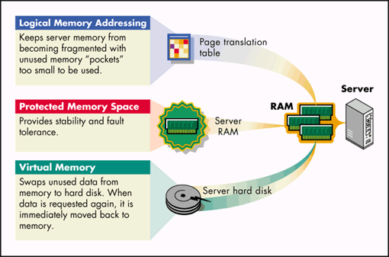
BTech-CSEN3103-Operating Systems

Slide 3
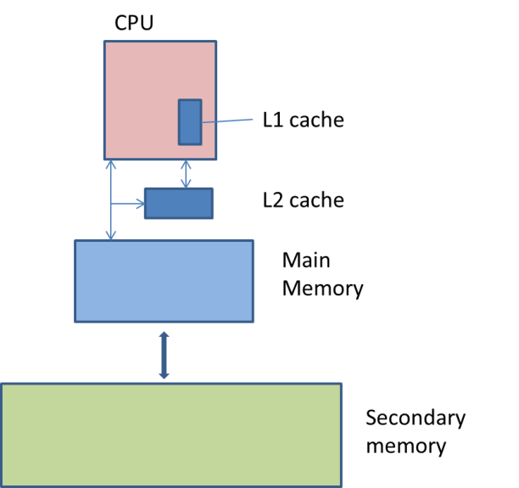
Memory Management → In the context of multiprogramming, we have two questions for OS:
1. Which program is to be brought into the main memory?
2. Which one of the resident programs should be executed next?
2nd question talks about process management (next slide).
1st question deals with efficient memory management (5th slide).
In a computer system, there is a hierarchy of storage elements organized such that the fastest memory is closest and directly accessible by the CPU shown in the following figure:
BTech-CSEN3103-Operating Systems

Slide 4
Just refresh with processes that are entering into Memory (Main Memory – MM; Virtual Memory - VM)
Concept of Process (process runs with resource)
Process Management
Process Synchronization
Scheduling Algo.
Reader Writer, Dining Philosophers, Producer Consumer
Semaphore
Deadlock
Threads
Starvation
Prevention
Detection
Avoidance
Recovery
Resource Allocation Graph, Banker’s Algo.
Context Switch
CS , Mutual Exclusion
Process States, PCB etc.
Monitors
BTech-CSEN3103-Operating Systems

Slide 5


1. The main memory accommodates :
a) operating system b) CPU
c) user processes d) All of these
Ans: a & c
2. Which of the following is/are the requirements of memory management.
i) Relocation ii) Protection iii) Sharing iv) Memory organization
A) i, ii and iii only B) ii, iii and iv only
C) i, iii and iv only D) All i, ii, iii and iv
Ans: A)
3. Main memory in a computer system is ………………. as a linear or one dimensional, address space, consisting of a sequence of bytes or words.
A) relocated B) protected C) shared D) organized
Ans: d)
4. Once a program is compiled, it can be loaded for execution
a. Only from the compiler generated starting address
b. Any where in the main memory
c. User needs to specify where the compiled code is to be loaded
d. It is loaded starting from address 0 in the main memory.
Ans: a)
BTech-CSEN3103-Operating Systems

Slide 6


CPU
MMU (responsible for translating logical addr. [CPU] to physical addr. [MM])
L1 Cache
L2 Cache
MAIN MEMORY (MM)
Kernel User
Space Space
Frames (MM)
High level & run-time libraries
Pages/Segmentation
Virtual Memory
Disk (Secondary Memory)
Disk Scheduling (Best Fit, First Fit,
Worst Fit)
BTech-CSEN3103-Operating Systems

Slide 7
CSEN3103: Our Own Memory Management…..
On-chip cache (L1) is the closest and fastest memory. The secondary memory is largest, slowest and farthest from the CPU. Cache and main memory are directly accessible by the CPU, because these memories are byte or word addressable. The secondary memory, being a block device, is not directly accessible by CPU. This means the data from the secondary storage can be accessed in the form of blocks.
For example: in a disk, the sector is the smallest addressable unit. Thus, the data from a disk can be brought in (or read) in terms sectors or in multiples of sectors. Generally, the size of a sector is 512 bytes. The sector, brought in from disk, is loaded into the main memory in such a way that each of 512 bytes of the sector gets an address in the memory location.
BTech-CSEN3103-Operating Systems

Slide 8
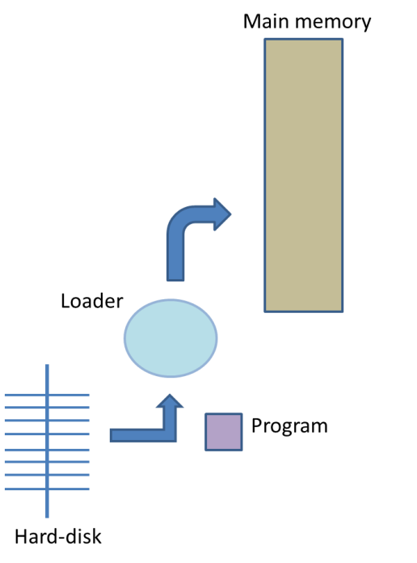
Loader
The secondary memory is the permanent memory of the memory system. Therefore, the files are stored in secondary memory. Ex. In a computer system, the program files and data files are on a hard disk.
At the time of execution, the programs are loaded into main memory from secondary memory by a system program called loader.
BTech-CSEN3103-Operating Systems

Slide 9
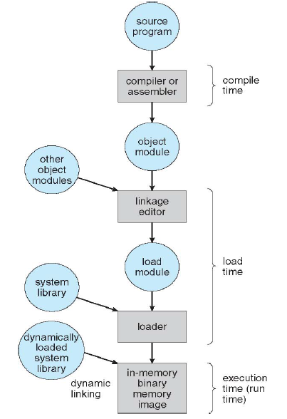
Multistep Processing of a User Program
BTech-CSEN3103-Operating Systems

Slide 10

Efficient Memory Management
The secondary storage contains thousands of programs, and the users may wish to run many of them. OS must know which programs needs to be moved into the MM next. For this OS has to address issues like Allocation, Relocation, Sharing and Protection in the context of processes running using sharable resources like CPU and MM….
Allocation : The operating system must open a process for the program being loaded by the loader. OS must also allocate main memory space for the incoming process and its associated data, so that it becomes a resident process (more info. on the allocation of main memory space in discussed in next slides….)
Relocation, Sharing and Protection: next slides….
BTech-CSEN3103-Operating Systems

Slide 11
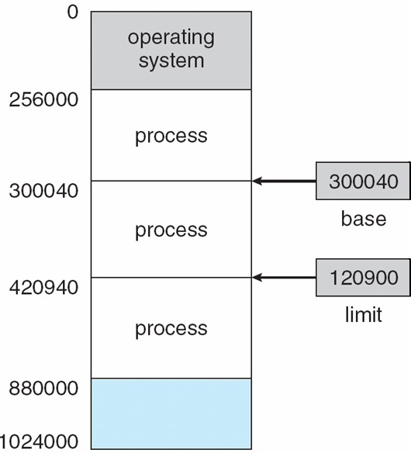
Allocation (cont.) : Base and Limit Registers needed for programs → processes loaded in MM
A pair of base and limit registers define the logical address space
CPU must check every memory access generated in user mode to be sure it is between base and limit for that user!
MM has OS area and user area with 3 processes loaded and free space
BTech-CSEN3103-Operating Systems

Slide 12
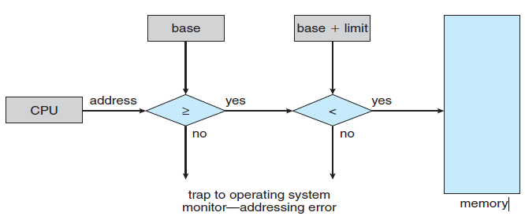
Allocation: Hardware Address Protection with Base and Limit Registers
Protection of memory space is achieved by having the CPU h/w compare every address generated in user mode with the registers. Any attempt by a program executing in user mode to access OS-memory or other user’s memory results in a trap to the OS, which treats the attempt as a fatal error.
<=
BTech-CSEN3103-Operating Systems

Slide 13

Relocation, Sharing and Protection
Relocation
  In a multiprogramming/multitasking environment, the processes are allocated memory space as and when they are loaded into memory.
  When the degree of multiprogramming decreases, some resident waiting processes are swapped out to the secondary storage and later swapped in, as and when their resources become available (next slide….)
  A relocatable program is compiled and linked in such a manner that its internal references are made relative to the address of the statement at its entry point.
  The program also contains a table of information about its statements which are ‘address sensitive’ (branch, procedure call statement etc.). This table is called the relocation table.
The degree of multiprogramming describes the maximum number of processes that a single-processor system can accommodate efficiently.
BTech-CSEN3103-Operating Systems

Slide 14

Relocation
Entry Point
Branch Statement
---------------------------- Program --------------------------------------
Data
In such a dynamic environment, it cannot be predicted as to what address a process will get loaded to. Therefore, the programs are built to be relocatable.
Relocation Table
BTech-CSEN3103-Operating Systems

Slide 15
Sharing and Protection
Sharing
  The system programs such as compilers and their libraries (stdio.h) need to be shared by multiple processes.
  The operating system ensures that access to shared applications, pages or databases is allowed to processes belonging to different users or groups, without compromising the integrity of the data, information or pages of the participating documents.
BTech-CSEN3103-Operating Systems

Slide 16
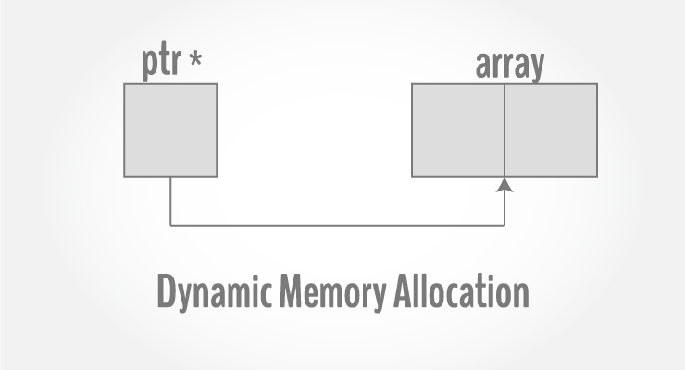
Protection
  The multiple resident processes frequently access their files and other resources.
  It becomes the responsibility of the operating system to manage the memory space in such a manner that no process, accidentally or otherwise, reads from or writes into the pages allotted to other processes. Example: C programs use pointers, i.e., OS monitors the addresses generated by a process at run time. This means the addresses generated by a process at run time must be restricted within the context of the process.
Dynamic memory allocation means to allocate the memory at run time. Dynamic memory allocation is possible by 4 functions of stdlib.h header file: malloc(), calloc(), realloc(), free()
BTech-CSEN3103-Operating Systems

Slide 17
Address Binding
Usually, a program resides on a disk as a binary executable file. To be executed, the program must be brought into memory and placed within a process. Depending on the memory management in use, the process may be moved between disk and memory during its execution. The processes on the disk that are waiting to be brought into memory for execution form the input queue.
BTech-CSEN3103-Operating Systems

Slide 18
Binding of Instructions and Data to Memory
Address binding of instructions and data to memory addresses can happen at three different stages:-
Compile time: If memory location known a priori, absolute code can be generated; must recompile code if starting location changes. (next slide…..)
Load time: Must generate relocatable code if memory location is not known at compile time. (next slide…..)
Execution time: Binding delayed until run time if the process can be moved during its execution from one memory segment to another. Need hardware support for address maps (e.g., base and limit registers). (next slide…..)
BTech-CSEN3103-Operating Systems

Slide 19
Address binding – Compile Time Binding, Load time and Execution Time Binding
Compile Time: If you know at the compile time where the process will reside in memory, then absolute code can be generated. Example, if you know that a user process will reside starting at location R, then the generated compiler code will start at that location and extend up from there. If the starting location changes, then it will be necessary to recompile this code.
Load Time: If it is not known at compile time where the process will reside in memory, then compiler must generate relocatable code.
Execution Time: If the process can be moved during its execution from one memory segment to another, then binding must be delayed until run time.
BTech-CSEN3103-Operating Systems

Slide 20
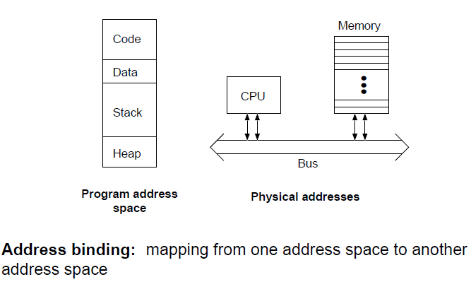
Address spaces
BTech-CSEN3103-Operating Systems

Slide 21
Logical vs. Physical Address Space
The concept of a logical address space that is bound to a separate physical address space is central to proper memory management.
  Logical address – generated by the CPU; also referred to as virtual address.
  Physical address – address seen by the memory unit.
Logical and physical addresses are the same in compile-time and load-time address-binding schemes; logical (virtual) and physical addresses differ in execution-time address-binding scheme.
BTech-CSEN3103-Operating Systems

Slide 22
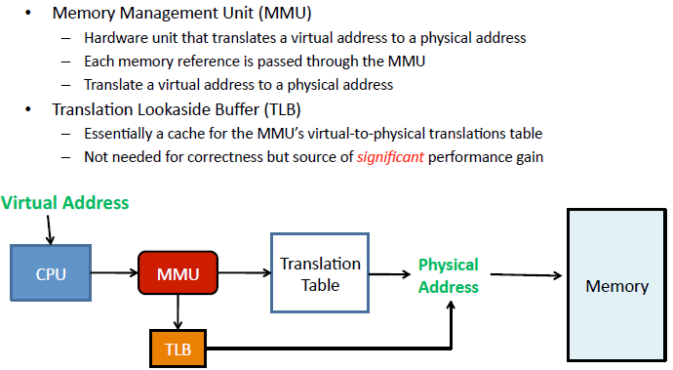
Memory-Management Unit (MMU)
/ Logical address
BTech-CSEN3103-Operating Systems

Slide 23
Memory-Management Unit (MMU) & TLB
Hardware device that maps virtual to physical address.
In MMU scheme, the value in the relocation register is added to every address generated by a user process at the time it is sent to memory.
The user program deals with logical addresses; it never sees the real physical addresses.
A translation lookaside buffer (TLB) is a memory cache that is used to reduce the time taken to access a user memory location. It is a part of the chip’s memory-management unit (MMU). The TLB stores the recent translations of virtual memory to physical memory and can be called an address-translation cache. A TLB may reside between the CPU and the CPU cache, between CPU cache and the main memory or between the different levels of the multi-level cache. The majority of desktop, laptop, and server processors include one or more TLBs in the memory-management hardware, and it is nearly always present in any processor that utilizes paged or segmented virtual memory..
BTech-CSEN3103-Operating Systems

Slide 24
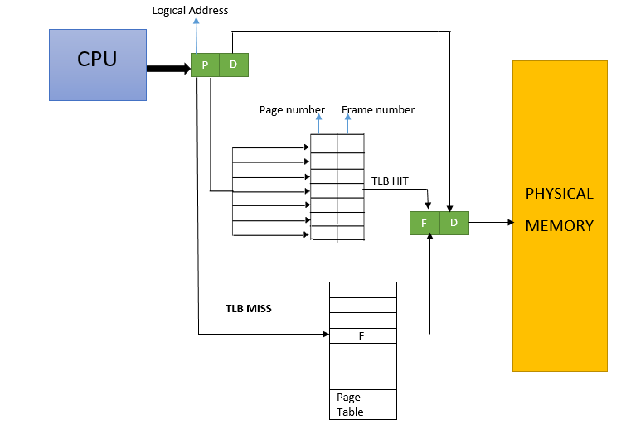
Memory Allocation
P: Page No.
D: limit (offset)
F: Frame No.
BTech-CSEN3103-Operating Systems

Slide 25
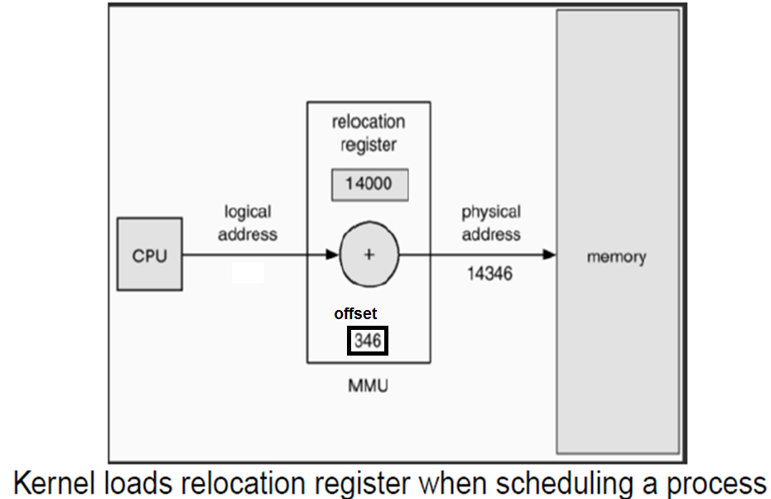
Dynamic relocation using a relocation register
BTech-CSEN3103-Operating Systems

Slide 26
Memory Allocation: Loading Programs into Main Memory
In order to accommodate multiple programs in the main memory, the OS divides the MM into two major parts, the system area and the user area. The task is to accommodate multiple user programs into the user area of the MM. The simplest way is to divide the memory into partitions:
  Fixed sized partitions
  Variable sized partitions
BTech-CSEN3103-Operating Systems

Slide 27
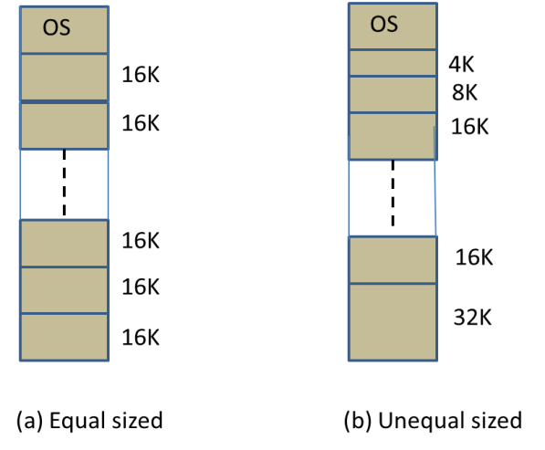
Fixed Sized Partitions can be of two types:
  Equal sized partitions
  Unequal sized partitions
Fig.
BTech-CSEN3103-Operating Systems

Slide 28
Fixed Sized Partitions can be of two types (from the last slide….)
For equal sized partition, the OS divides the main memory into equal sized partitions. Example: let us assume that the memory is divided into partitions of size 16K, each as shown in Fig. a) [previous slide]
Now, in this case, 16K becomes the upper limit on the size of the program that can be loaded in the MM.
Thus, a program larger than 16K cannot be executed because it cannot be loaded into the memory.
On the other hand, a program of size less than 16K would lead to memory wastage. For instance, a program of size 10K can be loaded into any of the available partitions but a memory chunk of size 6K will be wasted.
In fact, the smaller the size of the program to be loaded, more the wastage of memory that would occur. This wastage of memory within a partition is called Internal Fragmentation.
BTech-CSEN3103-Operating Systems

Slide 29
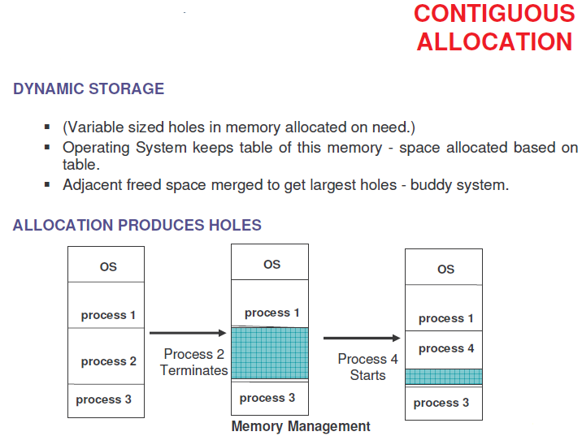
BTech-CSEN3103-Operating Systems

Slide 30
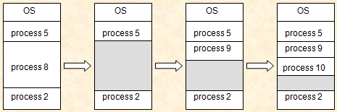
Contiguous Allocation (Cont.)
Multiple-partition allocation
  Hole – block of available memory; holes of various size are scattered throughout memory.
  When a process arrives, it is allocated memory from a hole large enough to accommodate it.
  Operating system maintains information about:
  a) allocated partitions b) free partitions (hole)

Slide 31
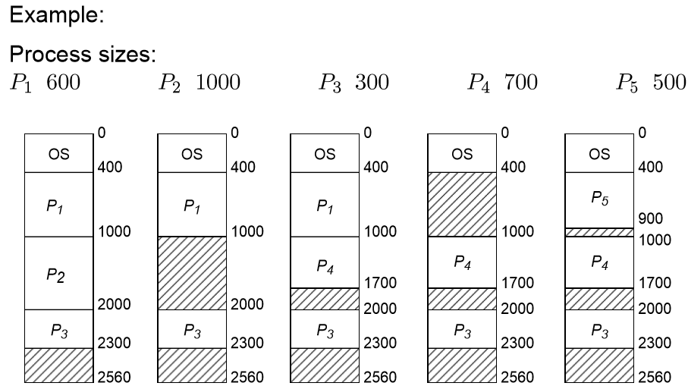
BTech-CSEN3103-Operating Systems

Slide 32
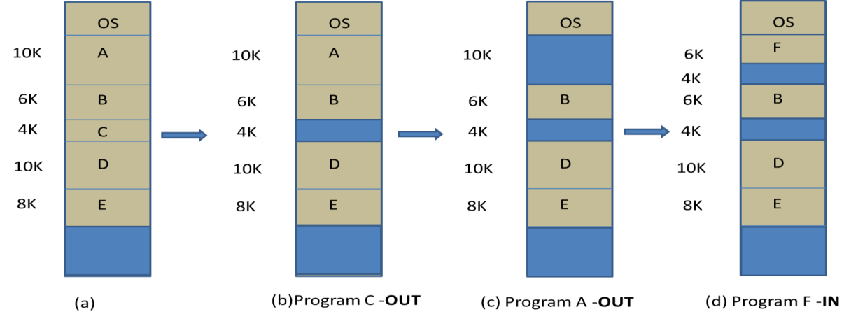
Variable Sized Partitions
Here, the programs are loaded into the memory in the order of their arrival.
As the programs are of different sizes, the memory is dynamically divided into variable sized partitions. Therefore, this scheme of partitioning is also called dynamic partitioning.
FIG-A
BTech-CSEN3103-Operating Systems

Slide 33
Variable Sized Partitions
From the figure A (a) in last slide, its noted that initially, there is no memory fragmentation. A chunk of memory is available towards the end for incoming user programs. Let us assume that program ‘C’ finishes its job and leaves the memory. It leaves behind a memory block (hole) of size 4K. Now we have two chunks of memory, i.e., a chunk of 4K and a large chunk at the end of the memory (Fig A (b)). If, at this moment, program A of size 10K also leaves, then we are left with another memory block of size 10K. In fact, by now the memory is fragmented into three memory holes (shown in Fig A ©).
This type of memory fragmentation created by outgoing programs is called as external fragmentation. As programs move in and out, the memory holes become smaller and smaller (Fig A (d)). Note that, in the example shown in Fig A, a program called F, of size 6K, has joined the system. OS has loaded the new entrant into the 10K hole leaving behind a hole of size 4K…. (moving towards compaction)…..
Solution: The problem of external fragmentation is solved by moving the resident programs into a big chunk of contiguous programs and the fragmented memory into another chunk of free memory. This activity is known as storage compaction.
BTech-CSEN3103-Operating Systems

Slide 34
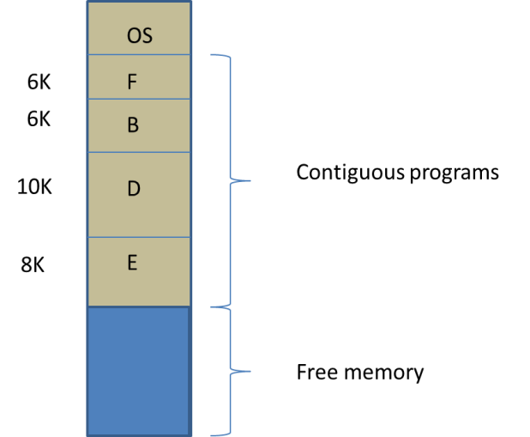
Storage Compaction
Incoming programs can be accommodated in the free memory space created by storage compaction.
It is a time-consuming exercise, leading to slowing of the system.
It avoids external fragmentation.
BTech-CSEN3103-Operating Systems

Slide 35
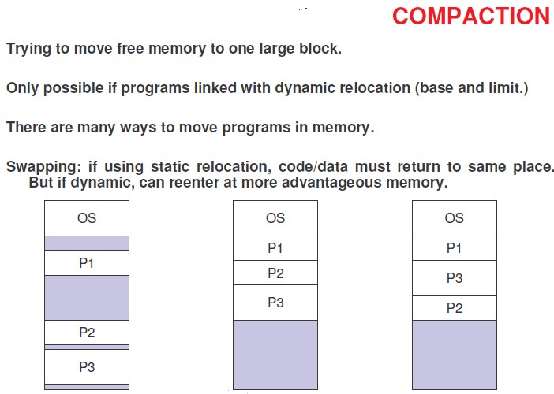
BTech-CSEN3103-Operating Systems

Slide 36
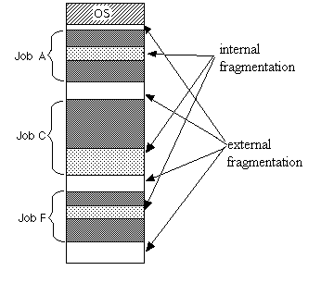
Justify if Internal and External fragmentations are OK….
BTech-CSEN3103-Operating Systems

Slide 37
Loading Policies
External fragmentation happens and adapts using any of the following loading policies to load the incoming programs in MM:
  First fit policy
  Best fit policy
  Next fit policy
BTech-CSEN3103-Operating Systems

Slide 38
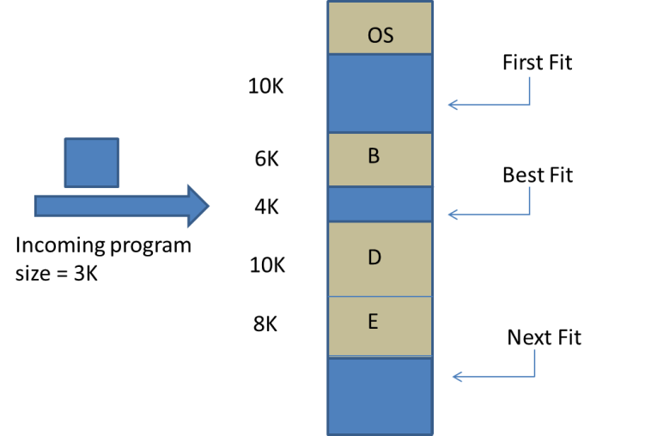
Loading Policies: First Fit Policy
The first free memory block, from the start of the memory, whose size is more than equal to the size of incoming program is found. Thereafter, the incoming program is loaded into that free memory block as shown in Fig. A
Fig. A
BTech-CSEN3103-Operating Systems

Slide 39
Loading Policies: First Fit (Continued…), Best Fit Policy and Next Fit Policy
FF: It may be noted that the first free memory block is of size 10K. Therefore, the incoming program of size 3K will be loaded into this block, thereby creating another memory chunk of size 7K. Disadvantage: This may lead to severe problem of external fragmentation.
BF: The operating system searches for a free memory block whose size is just more than or equal to the size of the incoming program. Thus, under this policy, the 4K memory block is chosen, thereby leading to the least external fragmentation.
BF: As this policy spends some time searching for the best suited memory block, the system becomes slow.
NF: The operating system keeps a pointer to the location where the last program was loaded.
NF: From that pointer onwards, it finds the next free memory block and loads the incoming program.
BTech-CSEN3103-Operating Systems

Slide 40
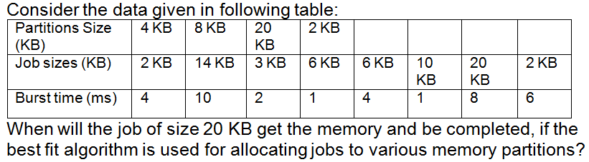

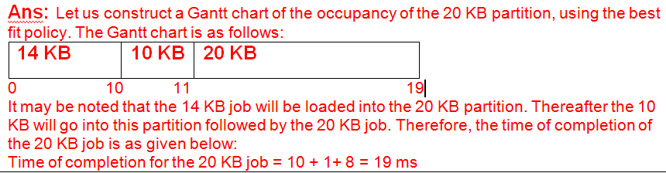
20
KB
BTech-CSEN3103-Operating Systems

Slide 41
Segmentation
A program consists of the following components:
  Code: This part of the program contains the program instructions. These instructions are compiled by the compiler into the target machine code. It is marked ‘read only’, indicating that it cannot be modified.
  Data: This part contains the data and the data structures defined by programmer.
  Heap: This component act as a pool for dynamic memory allocation to the program.
  Stack: The execution frames of functions are stored in a stack. The execution frames contain register values and contents of variables at a particular instant in the execution of the program. Thus, the compiler compiles the program into four types of relocatable segments – code, data, heap and stack as shown in fig A (next slide).
BTech-CSEN3103-Operating Systems

Slide 42
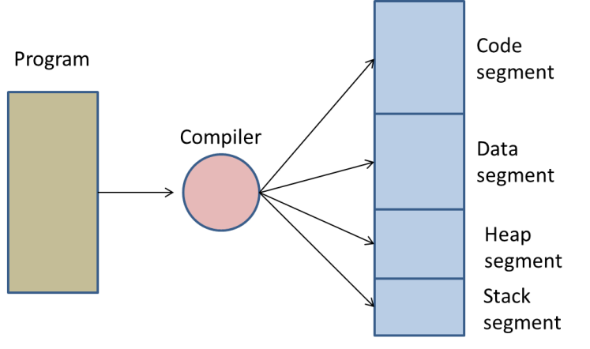
Segmentation
Program is compiled into segments
Fig A
BTech-CSEN3103-Operating Systems

Slide 43
Segmentation
When a segment is loaded into main memory, its starting main memory address is called the base address.
The size of the segment is stored in a table called the segment table. The segment table is indexed as per the segment numbers shown in fig B.
It may be noted that segment number 03 with size 60K has been loaded at a base address of 6500, and the corresponding entries have been made in the segment table at location 03.
Now when the program is executed, the CPU will generate an address (id, d) of an instruction/data to be fetched (Fig C). This address is easily translated to its corresponding main memory address . The segment id (say 03) is searched in the segment table and its corresponding base address (6500) is loaded into a register. The offset d (say 510) of the instruction is added to the base register, to obtain the main memory address of the instruction/data.
BTech-CSEN3103-Operating Systems

Slide 44
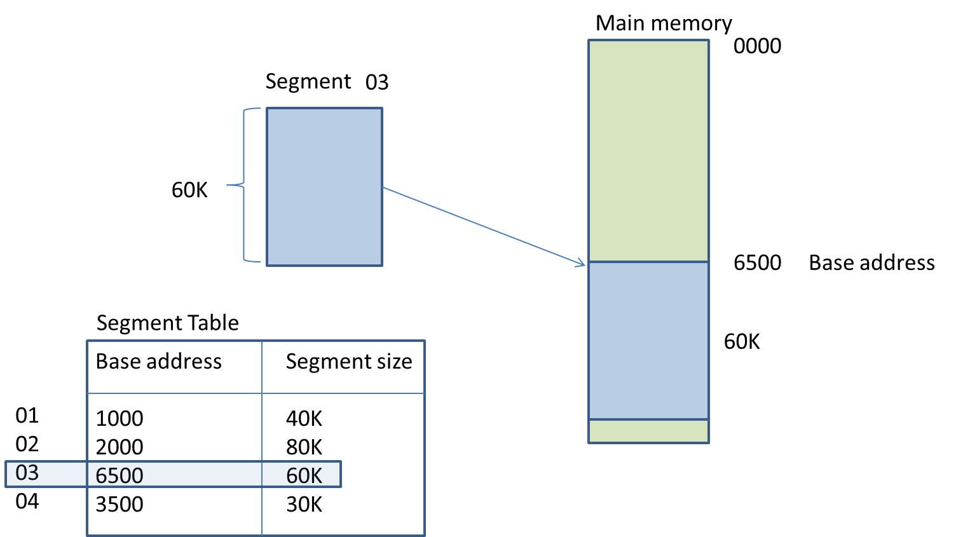
Segmentation
Fig B
Segment 03 is loaded into main memory
BTech-CSEN3103-Operating Systems

Slide 45
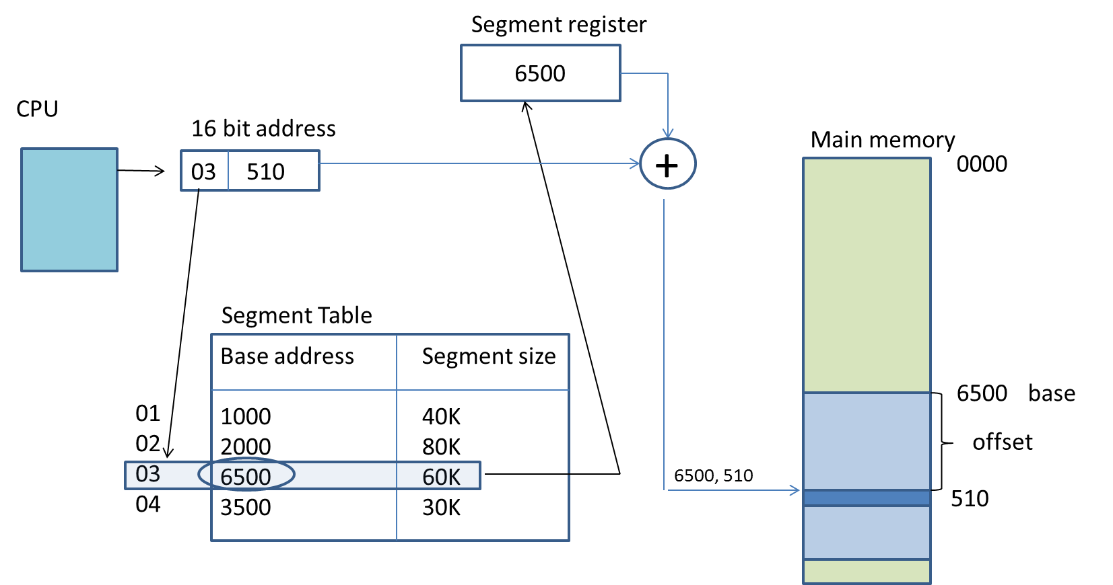
Address translation of instruction/data (id, d)
Fig C
BTech-CSEN3103-Operating Systems

Slide 46
Paging
The program and main memory are divided into equal sized partitions. The partitions of a program are called pages.
The partitions of main memory are called page frames.
Consider Fig P1 that shows the MM and program consisting of n and m numbers of page frames and pages respectively.
It may be noted that both pages and page frames are equal as well as fixed sized partitions.
Since the size of a page is the same as that of a page frame, any page of the program can be loaded into any available page frame of the main memory.
For each program, OS maintains a data structure called a Page table. Assuming that page numbers 3,5 and 2 are loaded into page frames 12, 4 and 1 respectively, the corresponding entries of the page table will be shown in Fig P2. The page table is stored in the main memory of the computer system.
BTech-CSEN3103-Operating Systems

Slide 47
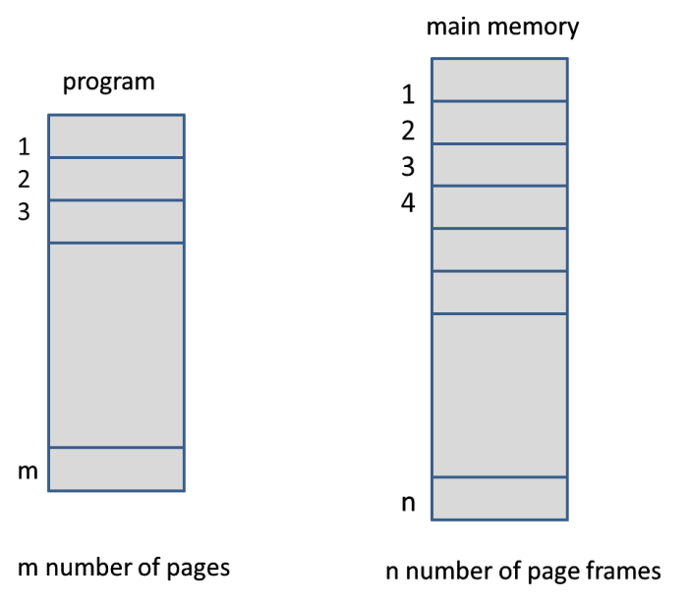
Paging → Pages and page frames
Fig P1
BTech-CSEN3103-Operating Systems

Slide 48
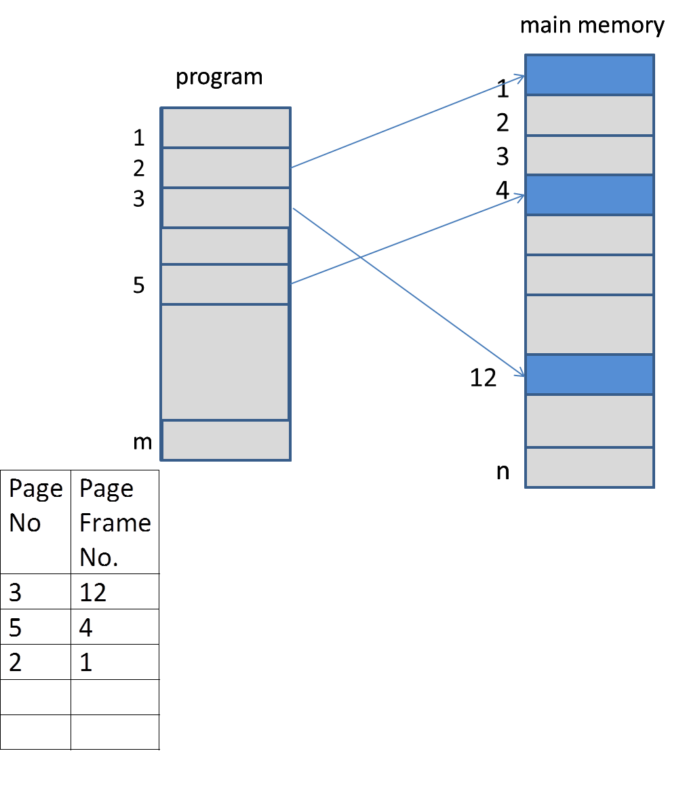
Paging
Fig P2
BTech-CSEN3103-Operating Systems

Slide 49
Paging
When the program is executed, the CPU generates an address (page no., offset) of an instruction/data to be fetched (fig.P3). This address is easily translated to its corresponding memory address. The page no. (say 03) is located in page table, and its page frame number (12) is picked up from there. The offset, d (say 230), of the instruction within the page, is added to the page frame number to obtain the main memory address of the instruction/data. The address mapping scheme shown in fig.P3 is known as direct mapping.
Since the page table is stored in the main memory, a complete primary storage cycle is required to access the page table. This means an access to a page involves the following two main memory cycles:
One memory cycle is needed for accessing the page table to find the page frame number in which the required page is stored.
The second memory cycle is used to access the page frame to read the instruction from, or write to the page stored therein.
BTech-CSEN3103-Operating Systems

Slide 50
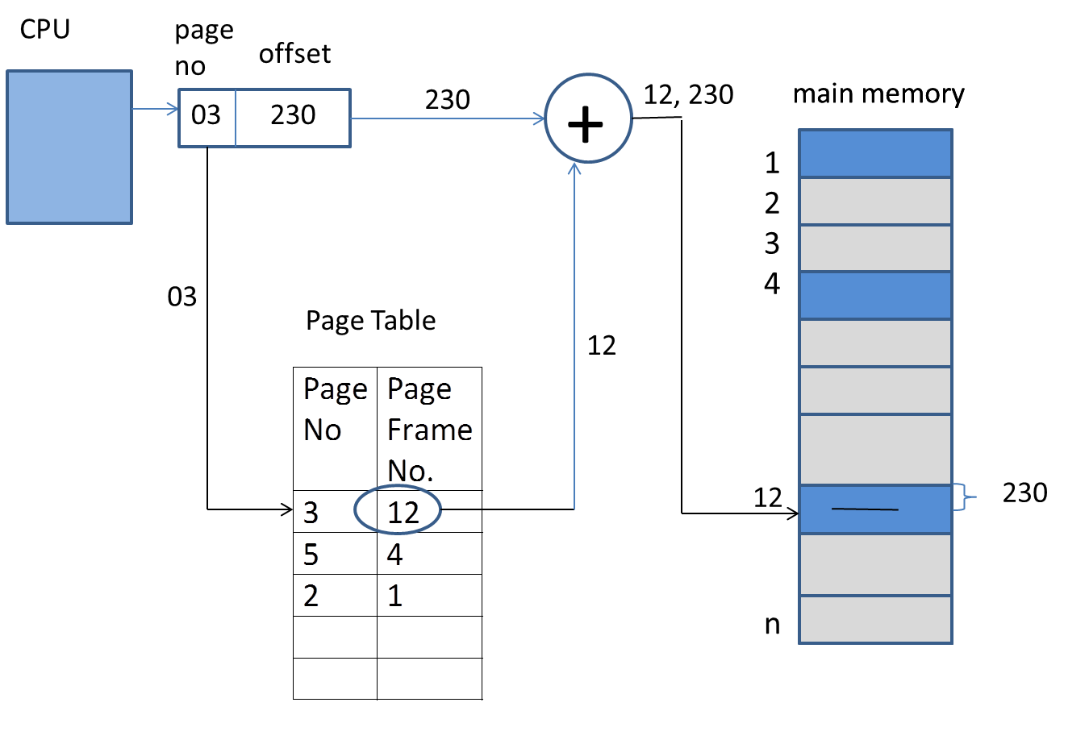
Address Translation in Paging
Fig P3
BTech-CSEN3103-Operating Systems

Slide 51


Hit Ratio and Miss Ratio
Hit ratio: If a page table entry is found, then it is called a hit. In case of a miss, the page is bought from the hard disk.
Hit ratio =
Miss ratio: Ratio of number of misses to total number of references.
  Miss ratio =
BTech-CSEN3103-Operating Systems

Slide 52

Paging Example
frames
BTech-CSEN3103-Operating Systems

Slide 53
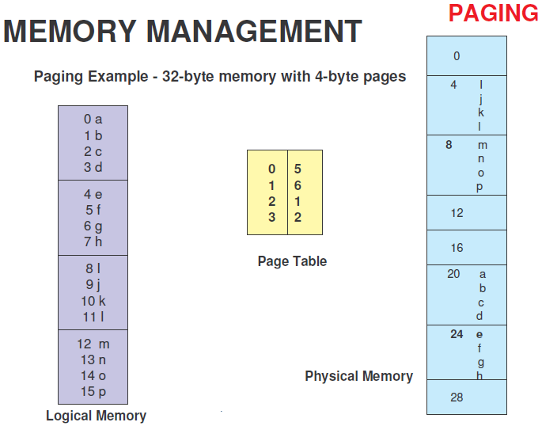
f0
Page 0
f1
Page #
Frame #
f2
Page 1
f3
f4
Page 2
f5
Page 3
f6
f7
BTech-CSEN3103-Operating Systems

Slide 54
Swapping
A process can be swapped temporarily out of memory to a backing store, and then brought back into memory for continued execution.
Backing store – fast disk large enough to accommodate copies of all memory images for all users; must provide direct access to these memory images.
Roll out, roll in – swapping variant used for priority-based scheduling algorithms; lower-priority process is swapped out so higher-priority process can be loaded and executed.
Major part of swap time is transfer time; total transfer time is directly proportional to the amount of memory swapped.
Modified versions of swapping are found on many systems, i.e., UNIX and Microsoft Windows.
BTech-CSEN3103-Operating Systems

Slide 55

Schematic View of Swapping
BTech-CSEN3103-Operating Systems

Slide 56
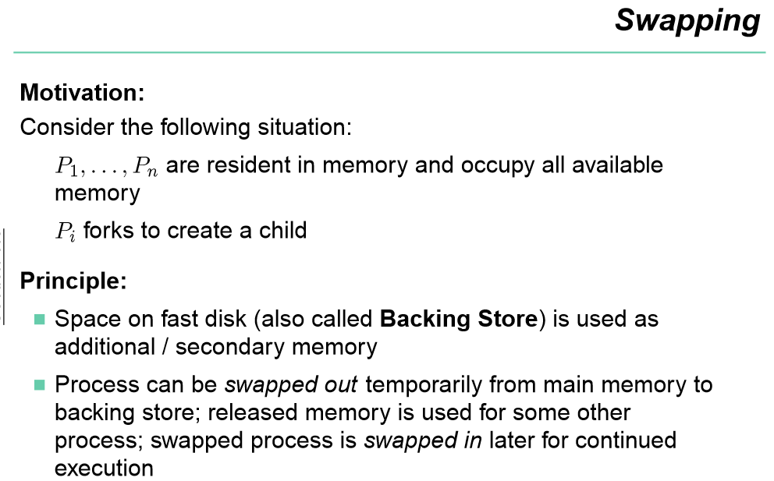
BTech-CSEN3103-Operating Systems

Slide 57

Operating System Concepts

Slide 58

Assignments:
If a process has 32 k bytes physical address space and the page size is 2048 bytes then the number of frames of that process is
a) 4 b) 8 c) 16 d) 32
Main memory space (physical address) = 32 k = 2⁵ × 2¹⁰ = 2¹⁵ , i.e., physical address space can fit into 15 bits;
Given Page size = 2048 bytes = 2¹¹;
How many frames can fit into main memory?
Number of page frames = 2¹⁵ / 2¹¹ = 2⁴ = 16 frames;

Slide 59




Paging
Pages =
No. of page frames =
=
=
BTech-CSEN3103-Operating Systems

Slide 60

Assignments:
Consider a logical address space of eight pages of 1024 words each, mapped onto a physical memory of 32 page frames. Answer the following:
How many bits are there in the logical address?
How many bits are there in the physical address?
Ans: (i) Given: No of pages = 8.
Size of each page = 1024 words;
Size of logical memory = 8 * 1024 = 2³ * 2¹⁰ = 2¹³ words
Thus the number of bits in the logical address = 13 bits
(ii) Given: No of page frames = 32.
Size of each page frame = size of page = 1024 words.
Size of physical memory = 32 * 1024 = 2⁵ * 2¹⁰ = 2¹⁵ words.
Thus the number of bits in the physical address = 15 bits

Slide 61

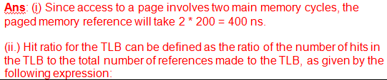

Assignments:
Consider a paging system with the page table stored in
the main memory. Answer the following:
If the main memory access time is 200 ns, how long does a paged memory reference take?
If we use TLB, and 75% of page table references are found in the TLB, then what is the effective reference time? (Assume that finding a page table entry in TLB takes zero time if the entry is found)

Slide 62

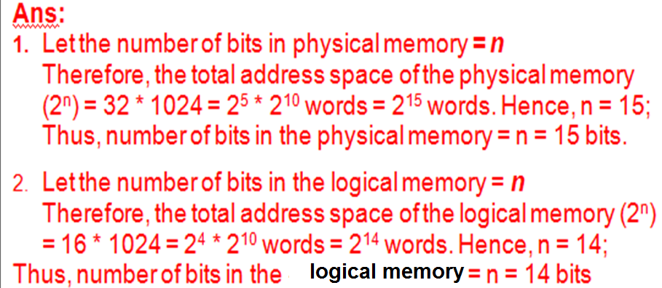
Assignments:
Consider a logical address space of sixteen pages of
1024 words each. If the physical memory has 32 page frames,
then,
How many bits are there in the physical address space?
How many bits are there in the logical address space?

Slide 63
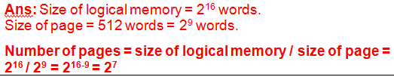
Assignments:
How many pages of size 512 words each, are contained in a program with a logical address having 16 bits?

